Slide 1

Analyzing Sentiments: Unveiling Insights through Text Evaluation

Slide 2

Introduction
In this presentation, we will explore the analysis of sentiments in text data and uncover valuable insights through evaluation. We will discuss the methodologies and tools used to understand the emotions and opinions expressed in text.

Slide 3


Text Evaluation Techniques
Various techniques such as sentiment analysis, natural language processing, and machine learning are employed to evaluate text. These methods help in identifying and understanding the sentiments expressed in the text data.

Slide 4


Insights from Sentiment Analysis
Sentiment analysis provides valuable insights into customer feedback, social media posts, and product reviews. It helps in understanding the public perception and can guide strategic decision-making.

Slide 5
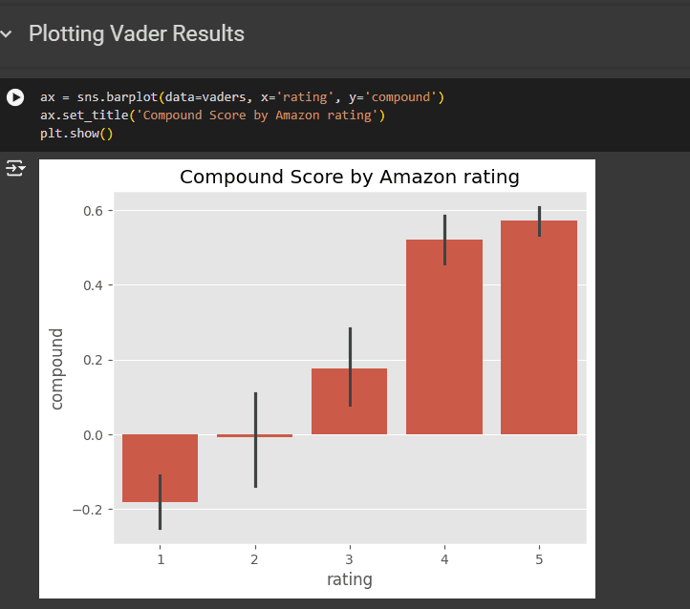
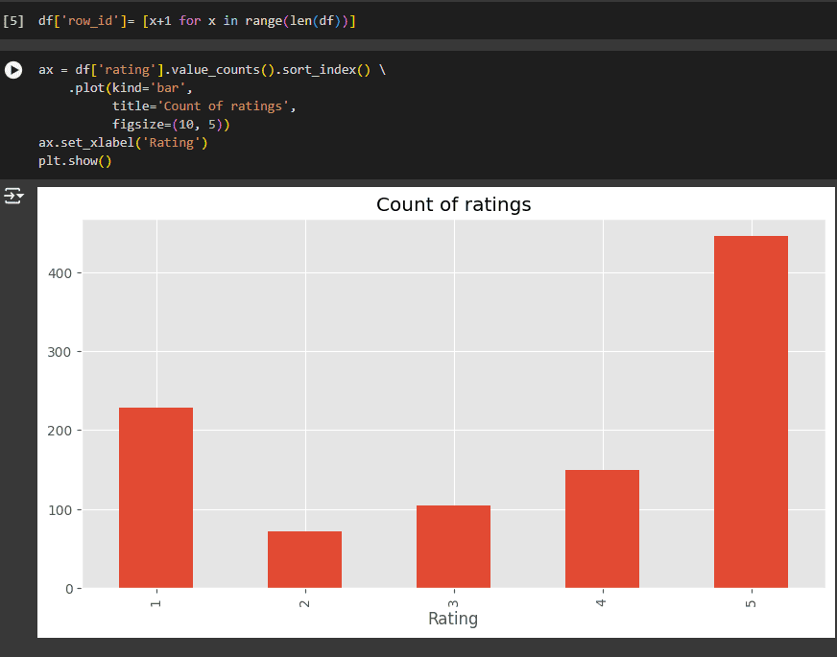
Data insights

Slide 6
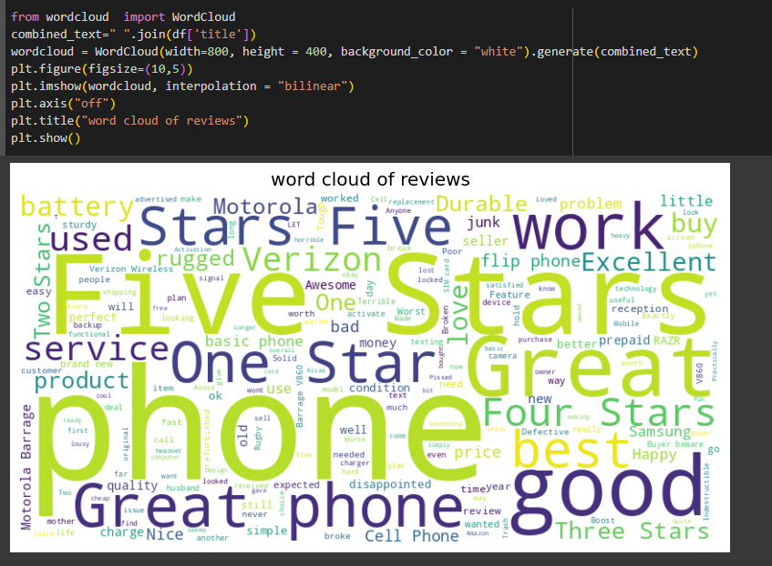
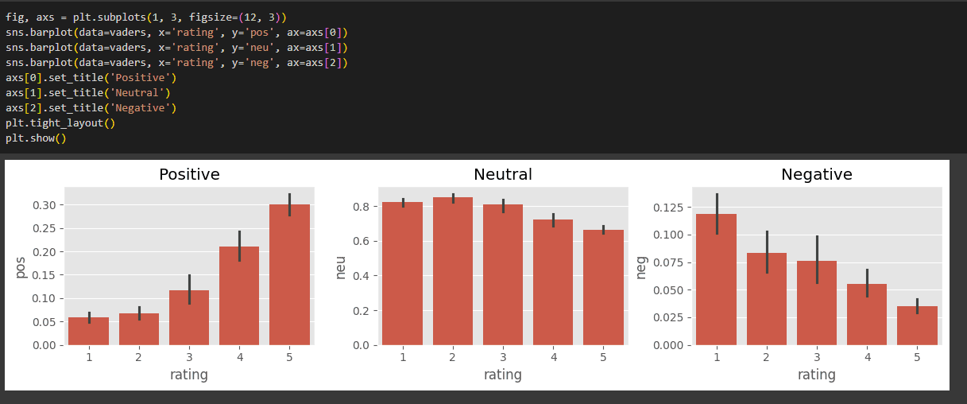
Data insights

Slide 7

Conclusion
In conclusion, text evaluation and sentiment analysis offer a powerful means to gain deep
insights into the emotions and opinions expressed in textual data. When applied effectively, these techniques can provide valuable strategic advantages for businesses and organizations.

Slide 8

Thanks!

